Slide 1
Team106online
Sprint 9

Slide 2
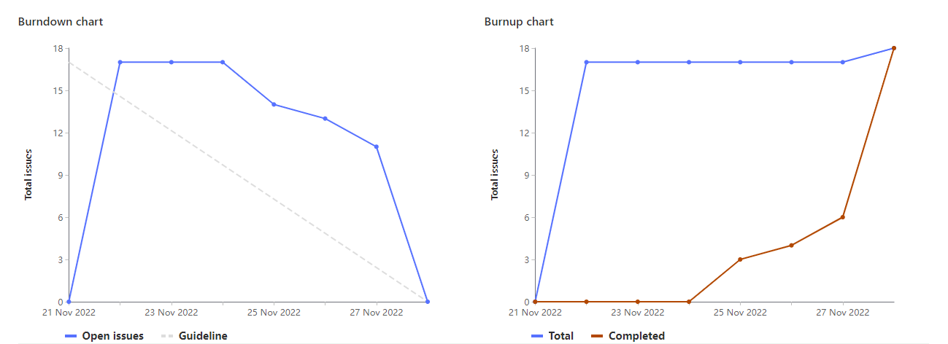
Sprint Progress

Slide 3
What Went Well
What To be Done Differently
Good pair programming sessions
Issues were made and assigned earlier than usual
Make sure not to overlap with other people’s work

Slide 4
Team Member: Caleb Beere
Work Highlights:
Total Weights: 22
Fixed course cookie reload bug with Hyrum and Parker
Refactored UI to strange interactions
Updated Wiki and README

Slide 5
Team Member: Parker Carnegie
Work Highlights:
Total Weights: 20
Code review for course suggestions with Rehan
Helped fix cookies not loading for W23 on refresh with Hyrum and Caleb
Updated documentation for clarity

Slide 6
Team Member: Ivan Odiel Magtangob
Work Highlights:
Total Weights: 21
Updating Selenium test cases + implementing unittest
UI improvements
Updated documentation (README/Wiki)

Slide 7
Team Member: Rehan Nagoor
Work Highlights:
Total Weights: 21
Researched selenium testing
Created Selenium tests with Ivan and Salmaan
Updated documentation for the selenium testing with Ivan

Slide 8
Team Member: Hyrum Nantais
Work Highlights:
Total Weights: 21
Reviewed and helped design suggestion feature with Sam
Fixed cookie setting bug with Caleb and Parker
Redesigned exam date schedule with Alif

Slide 9
Team Member: Samuel Guilbeault
Work Highlights:
Total Weights: 22
Created routes and SQL queries to power suggestion engine
Updated UI to support suggestion engine
Other UI tweaks

Slide 10
Team Member: Muhammad Salmaan
Work Highlights:
Total Weights: 20
Added selenium tests for front end
Refactored selenium code and made it into methods for testing with command line parameters with Rehan and Ivan
Additionally had code reviews and attended group meetings during the week.

Slide 11
Team Member: Alif Merchant
Work Highlights:
Total Weights: 21
Changed exam date schedule, including navigation
Improved UI components
Fixed linting errors

Slide 12

End

